Slide 1
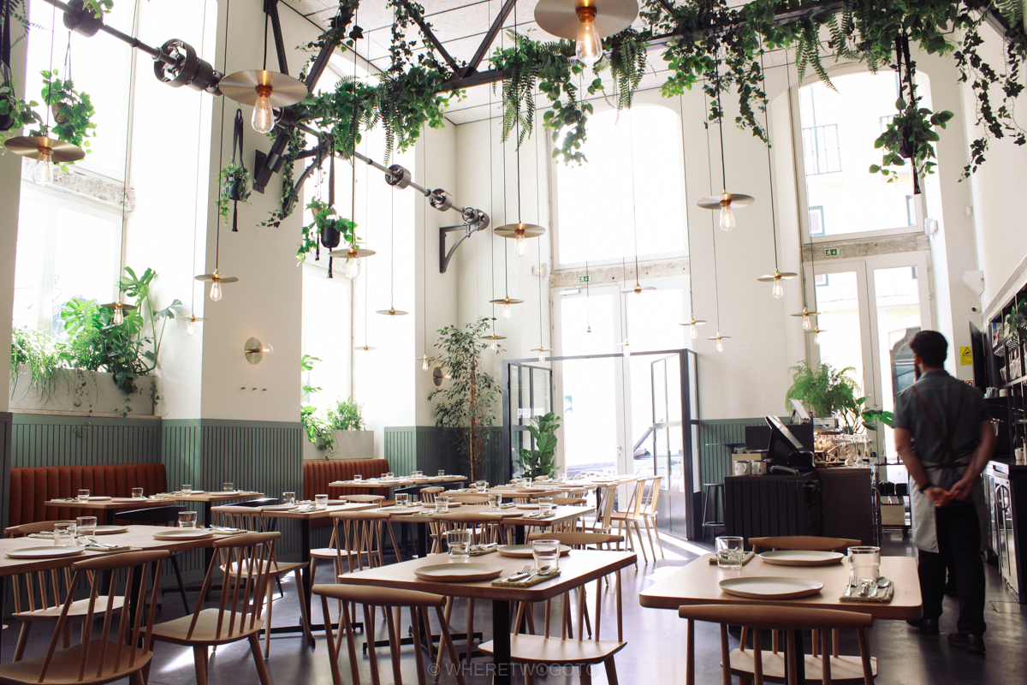
RESTAURANT WEBSITE
Made By : PRINCE DOGRA

Slide 2
ABOUT WEBSITE
Website contains Navigation bar providing multiple options to choose and LOGO of that respective restaurant.
Navigation Bar containts:
HOME.
ABOUT.
CATEGORY.
MENU.
TESTIMONIAL.
CONTACT US.
Website is static but compatible for mobiles as well.

Slide 3
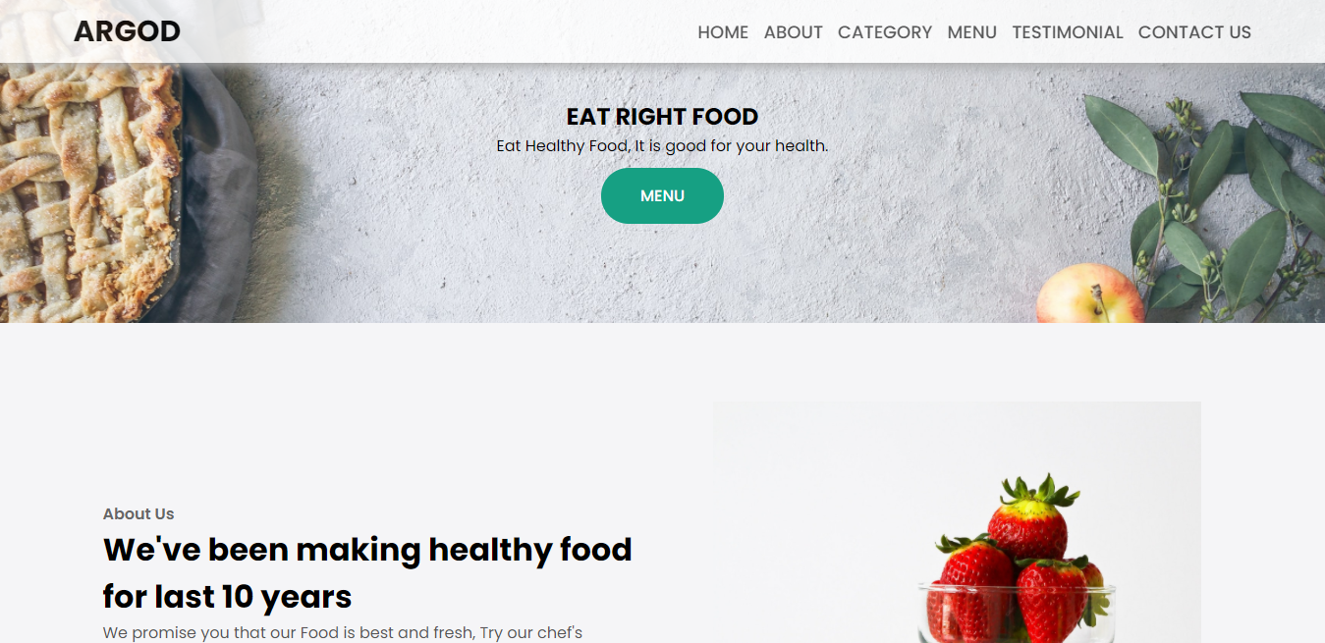
HOME PAGE & NAVIGATION BAR

Slide 4
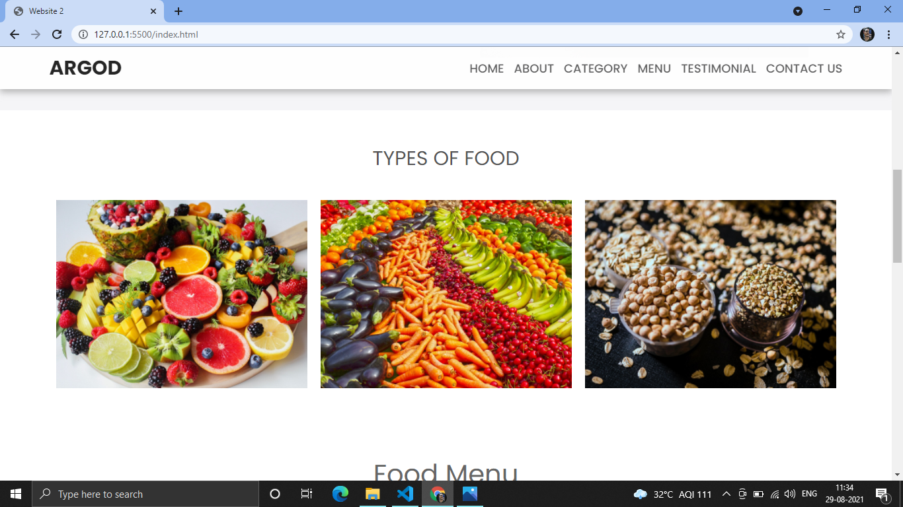
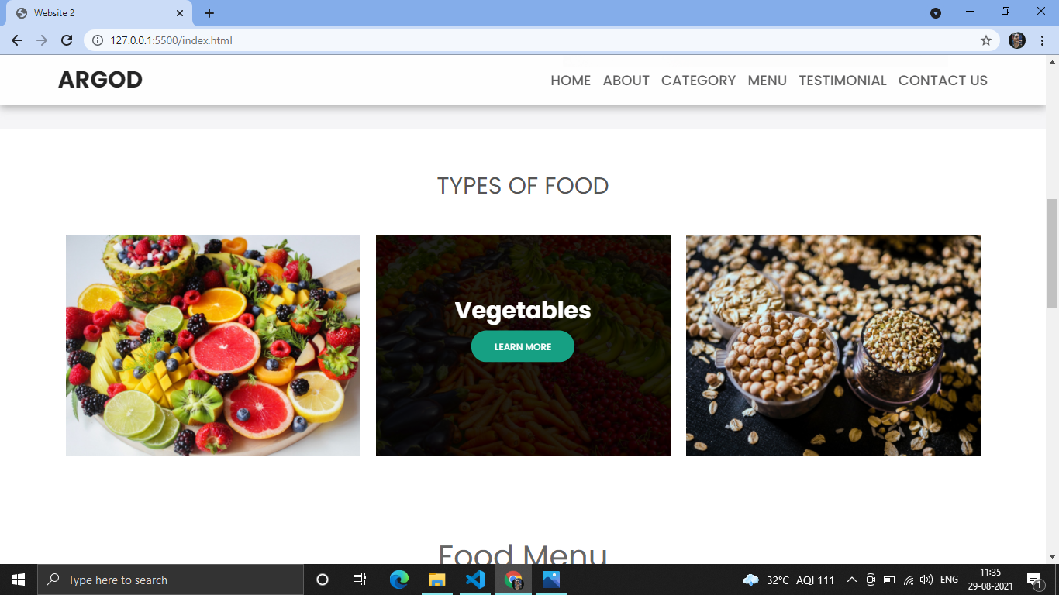
TYPES OF FOOD & OVERLAY EFFECT

Slide 5
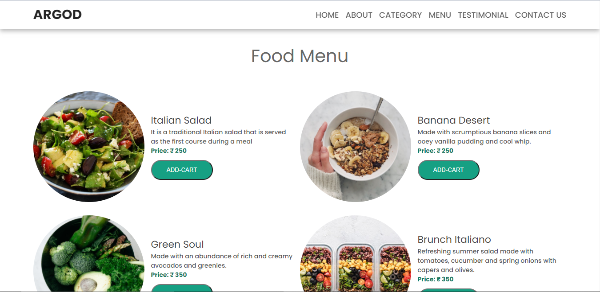
FOOD MENU

Slide 6
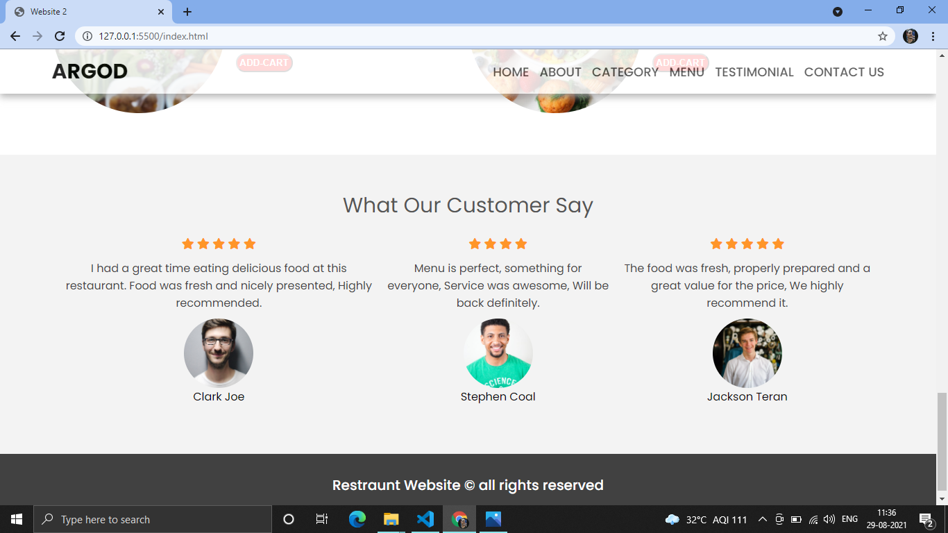
CUSTOMER REVIEW & FOOTER

Slide 7
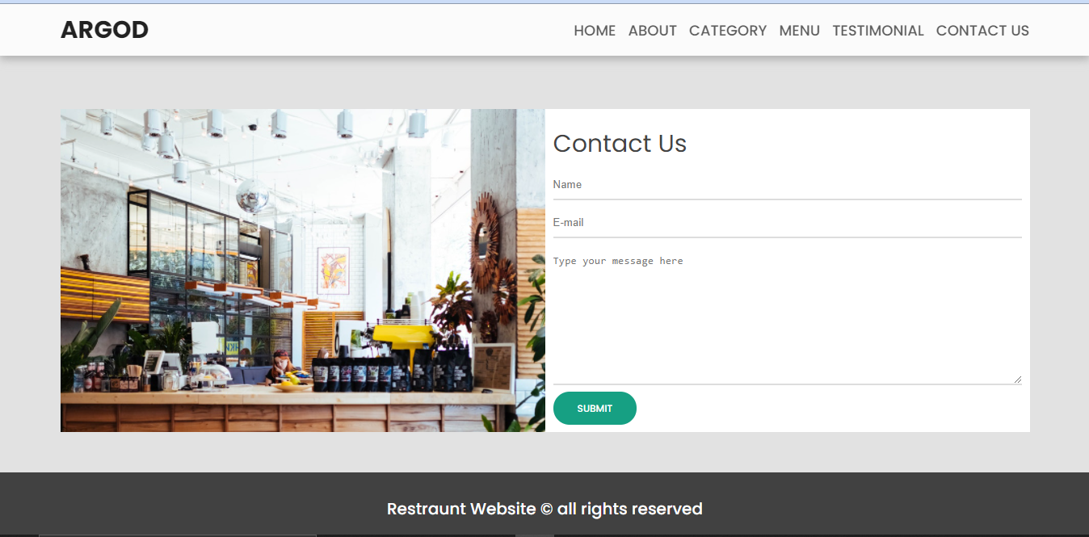
CONTACT US

Slide 8
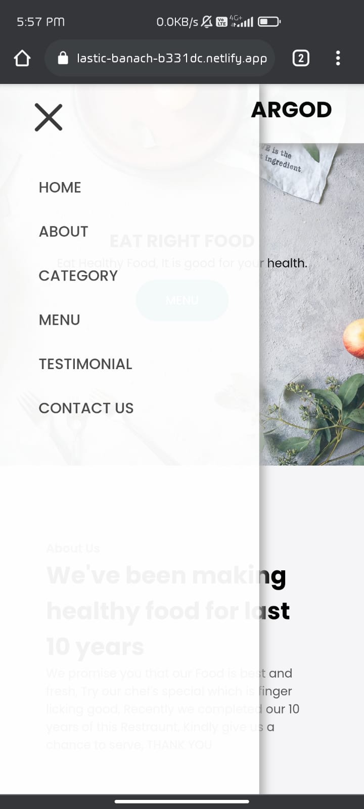
HAMBURGER MENU IN SMALL DEVICES Website is responsive, That makes webpages render well on a variety of devices and window or screen sizes from minimum to maximum display size. Provides an optimal experience for the user.

Slide 9
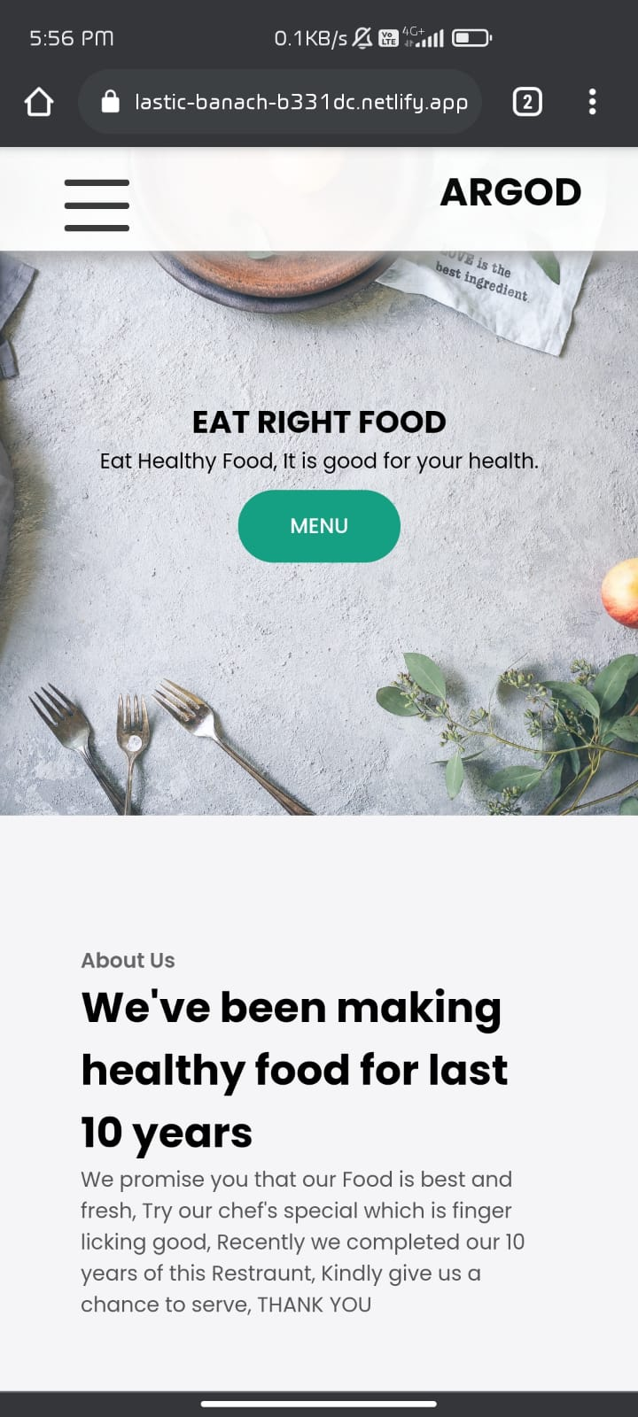
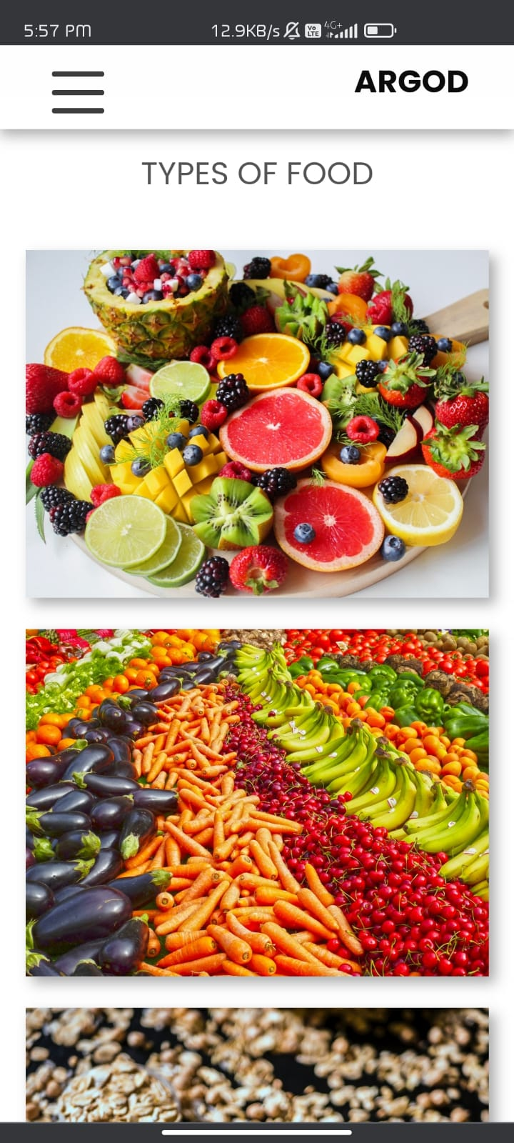
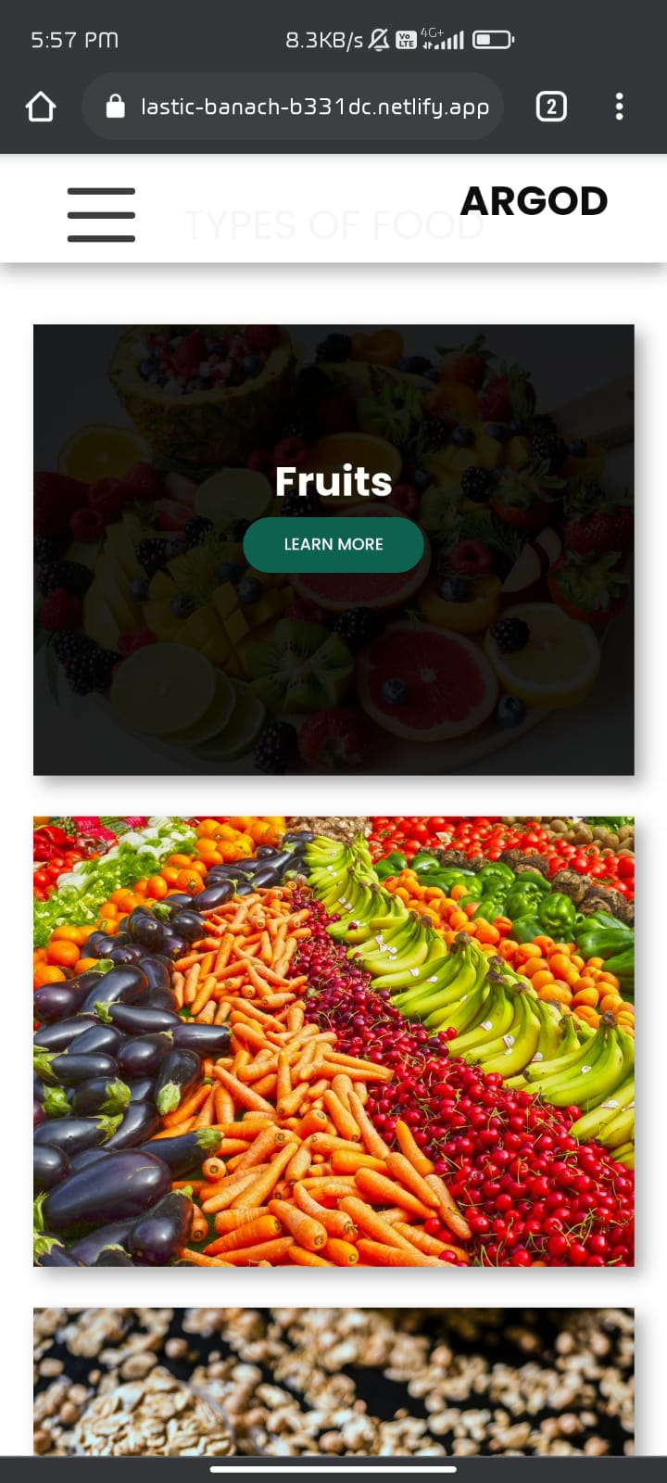
RESPONSIVE WEBSITE DESIGN IN MOBILE SCREEN

Slide 10
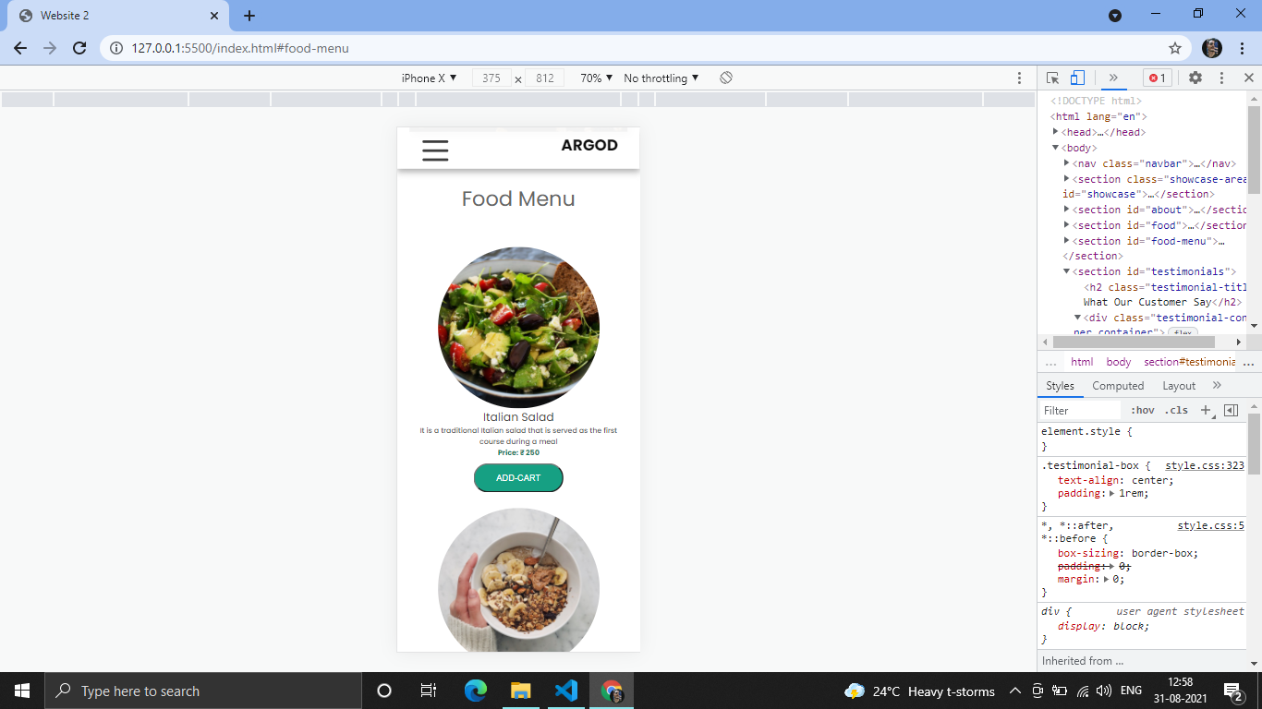
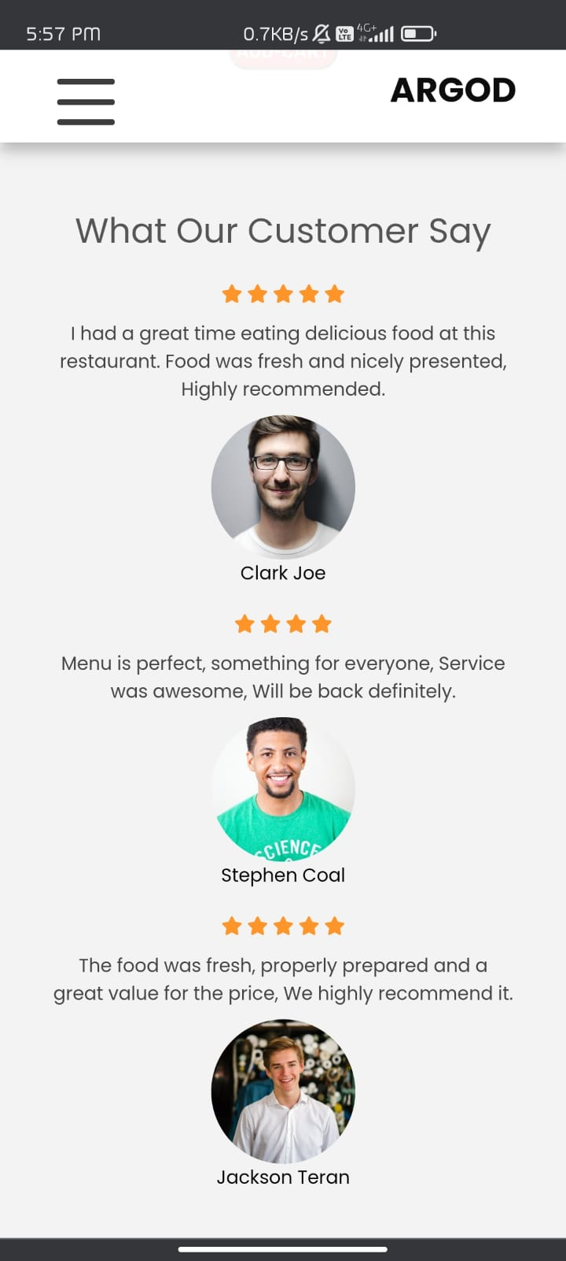
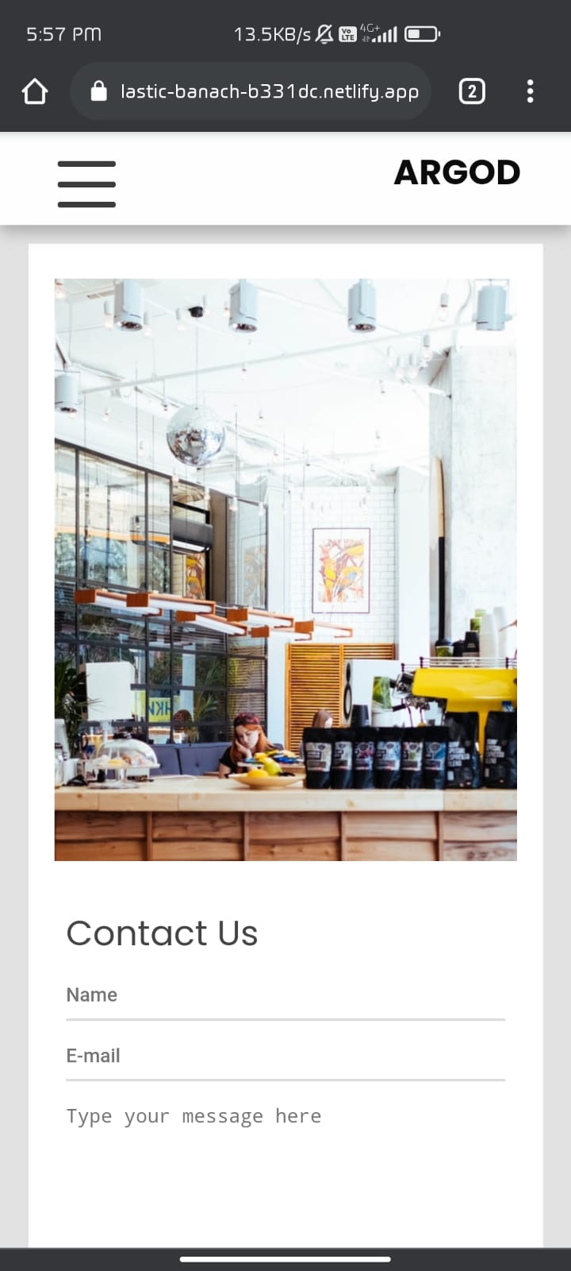
RESPONSIVE WEBSITE DESIGN IN MOBILE SCREEN

Slide 11
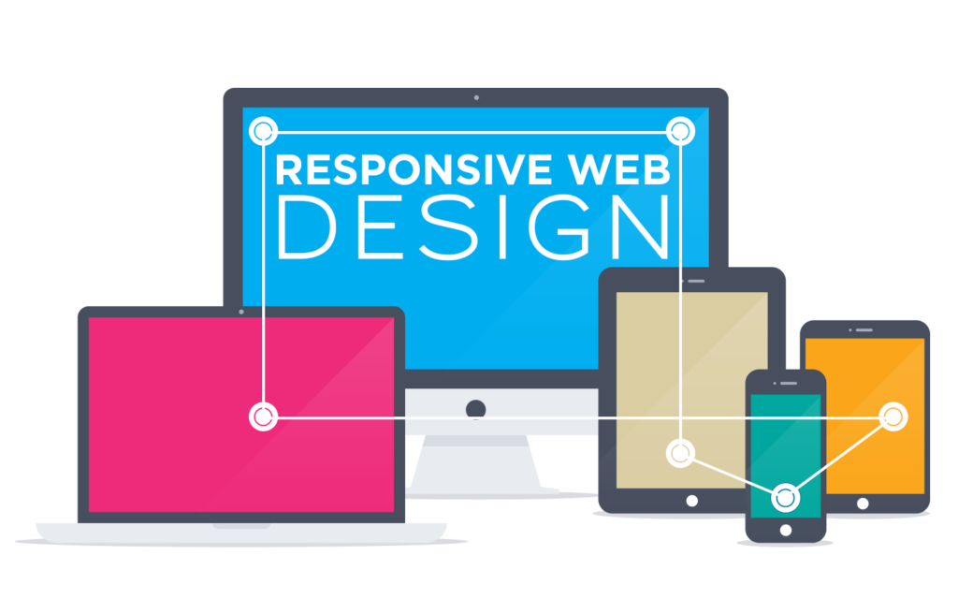
“”THANK YOU”” MADE BY: PRINCE DOGRA

